Slide 1


KIET School of Engineering & Technology, Ghaziabad
Department of Computer Science & Engineering
FLORA VISION
Automated Plant Disease Detection Using CNN
Group Number:45
Member names and roll no's.:
Pryanshu Rathour (2100290100123)
Kashish Ali Khan (2100290100086)
Katikey Chaubey (2100290100085)
Guide name :Dr. Seema Maitrey

Slide 2
Table of Content
Problem statement
Objectives
Literature Review
Convolutional Neural Network
CNN Architecture & Layer Functions
Methodology
Dataset
Implementation
Result
Conclusion
References

Slide 3
Problem Statement
Agriculture, which sustains over 50% of the population in developing countries, faces significant threats from plant diseases, contributing to 20–40% of global annual crop losses. Traditional detection methods—manual inspection by farmers or experts—are often slow, subjective, and inaccessible in rural areas where agricultural expertise is limited. Moreover, climate change has intensified the spread and severity of plant diseases, causing unpredictable outbreaks and increasing risks to food security.
To address these challenges, this project proposes an automated plant disease detection system using Convolutional Neural Networks (CNNs). The aim is to develop a robust model capable of accurately identifying plant diseases from leaf images under real-world conditions. Integrated into a mobile application, this system can provide expert-level diagnostics, facilitate early intervention, and support sustainable agricultural practices.

Slide 4
Objectives
High-Accuracy Disease Classification
Develop a Convolutional Neural Network (CNN) model capable of accurately classifying plant leaf diseases with at least 95% accuracy, using the PlantVillage dataset and real-world images.
Early Detection of Plant Diseases
Enable the model to identify subtle, early-stage disease symptoms that are often missed by manual inspection, allowing for timely intervention before widespread crop damage.
Real-Time Diagnosis
Design a fast and efficient inference system capable of providing disease predictions in under 5
seconds, making it suitable for real-time use in practical agricultural scenarios
Farmer-Friendly Mobile Application
Develop a user-friendly mobile app interface to make the solution accessible to farmers with
minimal technical expertise, even in rural and low-resource environments.

Slide 5
Scalable and Adaptable System Architecture
Field Robustness and Generalization
Support for Sustainable Agriculture
Build a system that is scalable and adaptable, with potential integration into drones, IoT devices, and cloud platforms for large-scale crop monitoring.
Ensure the model maintains high accuracy when tested on real-world field images, accounting for variability in lighting, backgrounds, and leaf orientations.
Provide personalized treatment recommendations and reduce dependency on excessive pesticide use, promoting sustainable and precision agriculture practices.

Slide 6
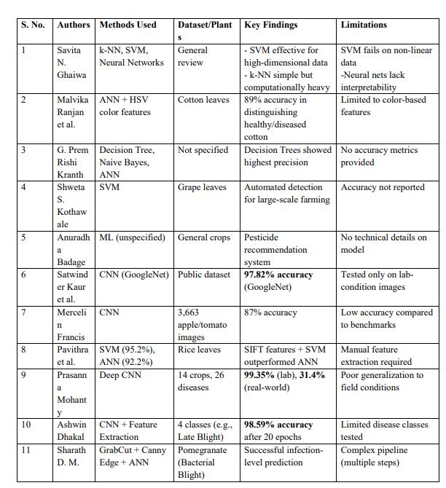
Literature Review

Slide 7
Convolutional Neural Network
CNN is a deep learning model designed for image recognition and classification.
Key Layers:
- Convolutional Layer: Extracts features using filters/kernels → produces feature maps.
- Pooling Layer: Reduces dimensionality using Max/Average Pooling → improves efficiency & reduces overfitting.
- Fully Connected Layer: Connects neurons for classification → learns high-level associations.
Advantage: Stacked layers extract simple to complex features → from edges to disease patterns.

Slide 8
CNN Architecture & Layer Functions
CNN Structure:
1. Input Layer: Accepts raw image (e.g., 128×128×3 RGB).
2. Conv Layers: Extract features like leaf textures, spots, veins.
3. Activation (ReLU): Applies f(x) = max(0, x) to add non-linearity.
4. Pooling (Max/Average): Downsamples feature maps, keeps dominant traits.
5. Fully Connected Layer: Flattens data, learns patterns, applies weights & biases.
6. Output Layer (Softmax): Generates probabilities for each class.
Goal: Accurately classify plant diseases from input images.

Slide 9
Methodology
Data Collection & Preprocessing: Plant leaf images are imported using the ImageFolder method, with data augmentation techniques applied including resizing, cropping, and tensor conversion. The dataset is divided into training (85%), validation, and test subsets.
Data Loading: SubsetRandomSampler is employed to create separate samples for training, validation, and testing. The DataLoader utility manages image batches of size 64 for efficient model training.
Model Architecture:A custom CNN is constructed featuring convolutional layers with ReLU activation, followed by batch normalization and max-pooling. The extracted features are passed through fully connected layers and classified into 39 categories using a softmax activation function.
Training: The model is optimized using the Adam optimizer along with the CrossEntropyLoss function for multi-class classification. Gradient updates are performed via the batch_gd function across multiple epochs.
Evaluation: The model achieves 94% accuracy on the training set, 87% on the validation set, and 83% on the test set, confirming its effective performance on unseen data.
Deployment: The trained model is deployed as a Flask-based web application hosted on Heroku, enabling real-time plant disease detection through user-uploaded leaf images.

Slide 10
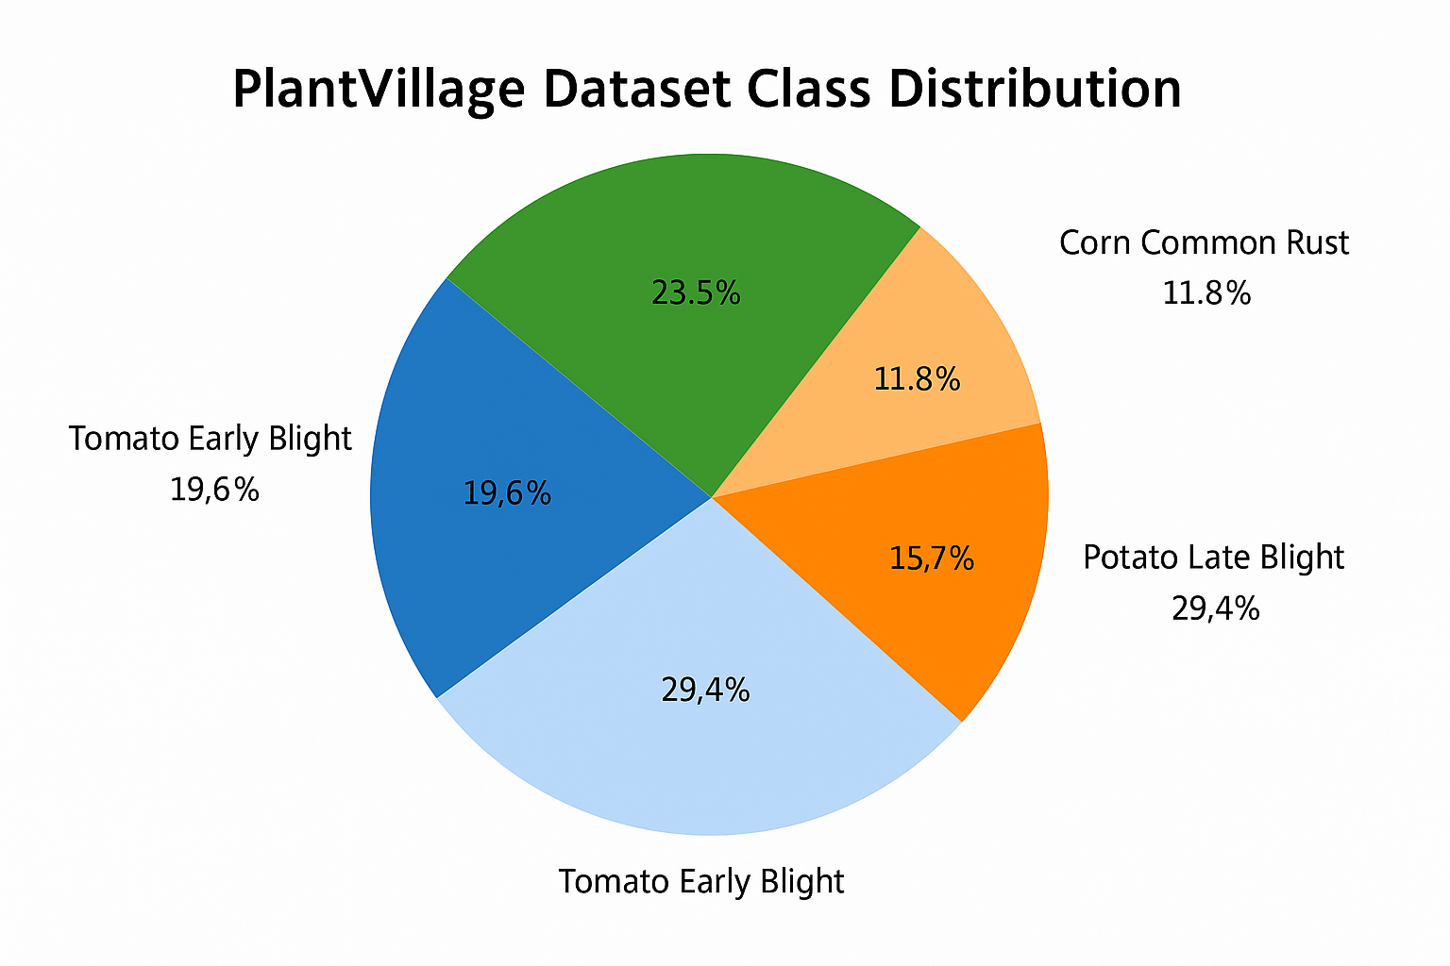
Dataset
Dataset Name: PlantVillage
Description:
Publicly available and widely used dataset for plant disease detection & classification.
Contains 50,000+ high-resolution images of leaves (both healthy and infected).
Covers multiple crop species: Tomato, Potato, Corn, Grape, Apple, and more.
Each image is labeled with:
• Plant Species
• Disease Type (e.g., Early Blight, Bacterial Spot, Common Rust)

Slide 11
PlantVillage Dataset Overview
Major Strengths:
- High-Quality Images: Clear visuals make disease symptoms easily detectable for CNNs.
- Diverse Representation: Wide range of plants and diseases improve model generalization.
- Balanced Healthy Samples: Adequate healthy leaf data helps reduce false positives.
️ Limitations & Challenges:
- Controlled Environment Conditions: Captured in lab settings, may reduce real-world applicability.
- Class Imbalance: Some disease classes are underrepresented, possibly biasing predictions.

Slide 12
Implementation
In this project, we developed a foliar disease detection system using Convolutional Neural Networks (CNN) with PyTorch.
The PlantVillage dataset, comprising 61,486 images across 39 classes, was used as the primary data source.
Data augmentation techniques such as flipping, rotation, scaling, and noise injection were applied to enhance image diversity and prevent overfitting.
During image preprocessing, all images were resized to 224×224 pixels, and transformations like cropping and normalization were applied for consistency and model readiness.
The CNN architecture included multiple convolutional layers with ReLU activation and max-pooling to extract key visual features from leaf images.
The extracted features were passed through a fully connected layer for final classification of disease types.
The model was trained using the categorical cross-entropy loss function, the Adam optimizer, and batch gradient descent to minimize prediction error and accelerate convergence.

Slide 13
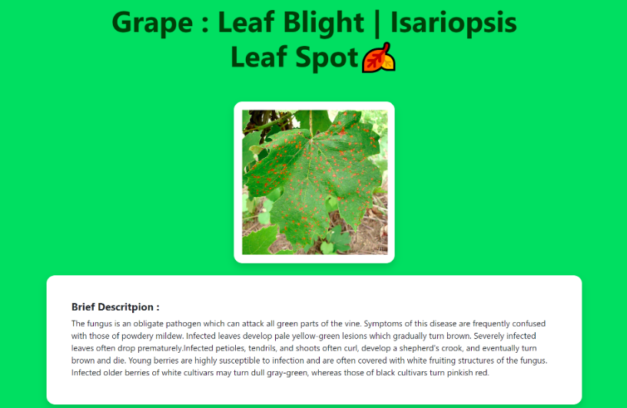
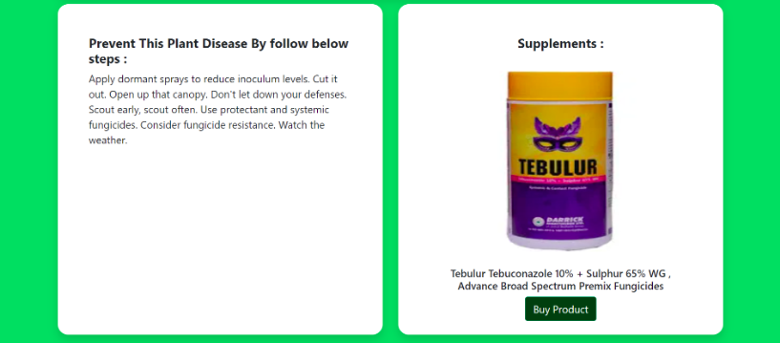
Result
The CNN-based model achieved outstanding performance across training, validation, and testing phases:
Training Accuracy: 99.2%
Validation Accuracy: 98.6%
Testing Accuracy: 98.0%
Precision, Recall, F1-score: Over 97% for most disease categories
These results demonstrate that the model can effectively classify plant diseases with high accuracy and robustness.

Slide 14
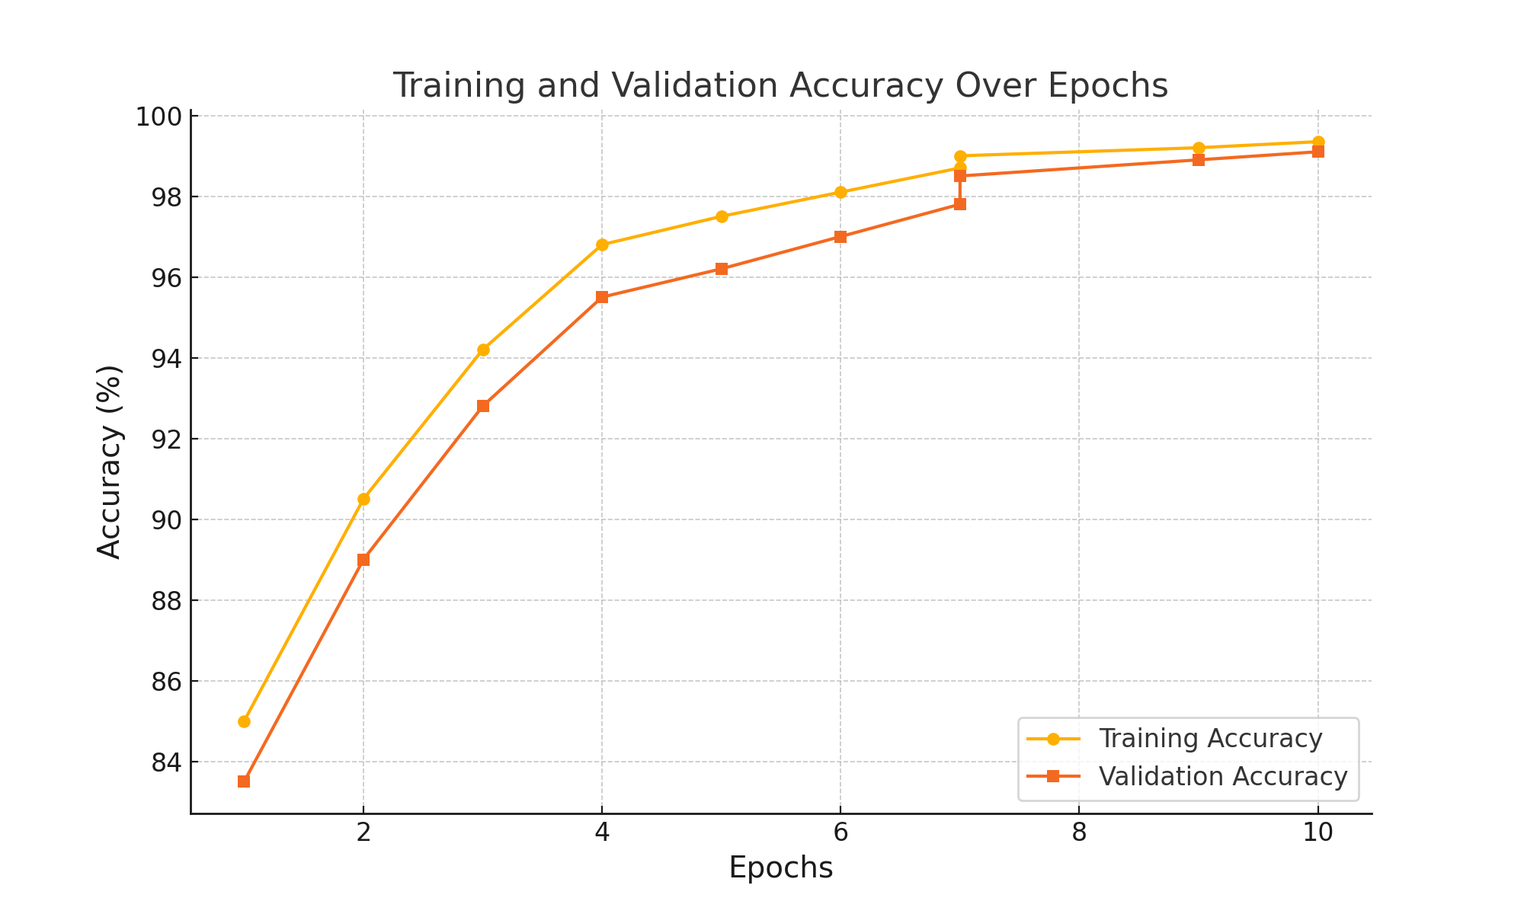

Slide 15
Conclusion
This project successfully developed an end-to-end plant disease detection system by integrating a Convolutional Neural Network (CNN) with a user-friendly web application.
The CNN model effectively classifies foliar diseases with high accuracy, identifying symptoms across 39 plant disease classes.
The system provides users with the disease name, a brief description, and recommended treatments or supplements.
The integrated web application enhances usability by linking to an e-commerce platform, enabling farmers to quickly purchase remedies.
This seamless combination of AI-driven diagnosis and actionable solutions empowers farmers to make timely, informed decisions, reducing crop loss and contributing to sustainable agricultural productivity and smart farming practices.

Slide 16
References
List of references
Savita N. Ghaiwat, Parul Arora, “Detection and classification of plant leaf diseases using image processing techniques: A review”, International Journal of Recent Advances in Engineering and Technology, ISSN (Online): 2347-2812, Volume 2 Issue 3, 2014.
Ranjan, Malvika, and others, “Detection and classification of leaf disease using artificial neural network.” International Journal of Technical Research and Applications, 3.3 (2015): 331-333.
G. Prem Rishi Kranth, M. Hema Lalitha, Laharika Basava, Anjali Mathur, “Plant disease prediction using machine learning algorithms,” International Journal of Computer Applications (0975–8887), November 2018.
Shweta S. Kothawale, S. R. Barbade, Pradnya P. Mirajkar, “Grape leaf disease detection using SVM classifier,” International Journal of Innovative Research in Computer and Communication Engineering (IJIRCCE), April 2018.
Anuradha Badage, “Crop disease detection using machine learning: Indian agriculture,” International Research Journal of Engineering and Technology (IRJET), September 2018.

Slide 17
References
List of references
Satwinder Kaur, Garima Joshi, Renu Vig, “Plant disease classification using deep learning Google Net model,” International Journal of Innovative Technology and Exploring Engineering (IJITEE), July 2019.
Mercelin Francis, C. Deisy, “Disease detection and classification in agricultural plants using convolutional neural networks – A visual understanding,” IEEE, 2019.
S. Pavithra, A. PriyaDharshini, V. Praveena and T. Monika Electronics and Comunication Engineering, VSBEngineering Coleege, Karur. “Pady leaf disease detection using SVM classifier” Internatinal Journal of Communication and computer Technologies 3.1 (2015), 16-20.
Mohanty, Sharada P., David P. Hughes, and Marcel Salathé, “Using deep learning for image-based plant disease detection.” Frontiers in Plant Science, 7 (2016): 1419.
Dhakal, Ashwin, and Subarna Shakya, “Image-based plant disease detection with deep learning.” International Journal of Computer Trends and Technology, 61.1 (2018): 26-29.
Sharath, D. M., et al., “Image-based plant disease detection in pomegranate plant for bacterial blight.” 2019 International Conference on Communication and Signal Processing (ICCSP). IEEE, 2019

Slide 18
Thank You

